Slide 1
Retail Store Management System
ITCS 3112 Term Project
David Miller
Nazmul Rabbi

Slide 2
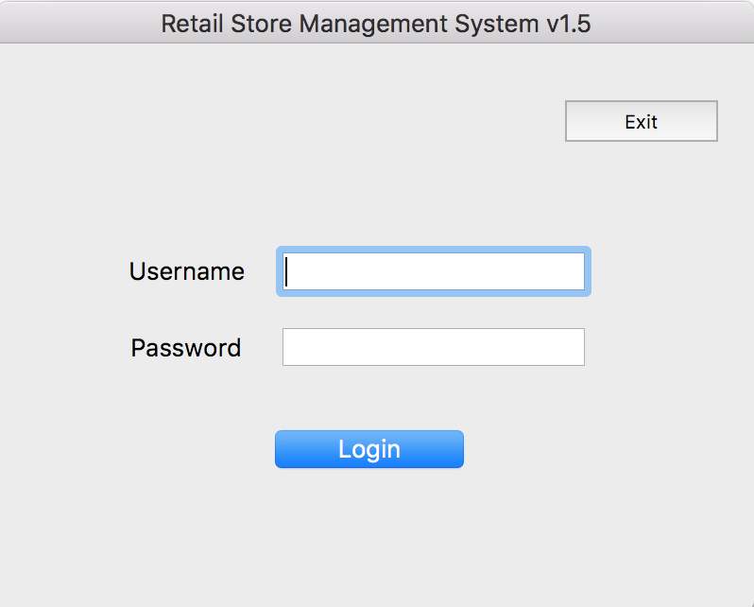
Login System

Slide 3
Features
Employee Login System
Allows Employees to log in and out of the system
User access control system which allows only allows an employee to interact with the system
Tracks which employee has logged in

Slide 4
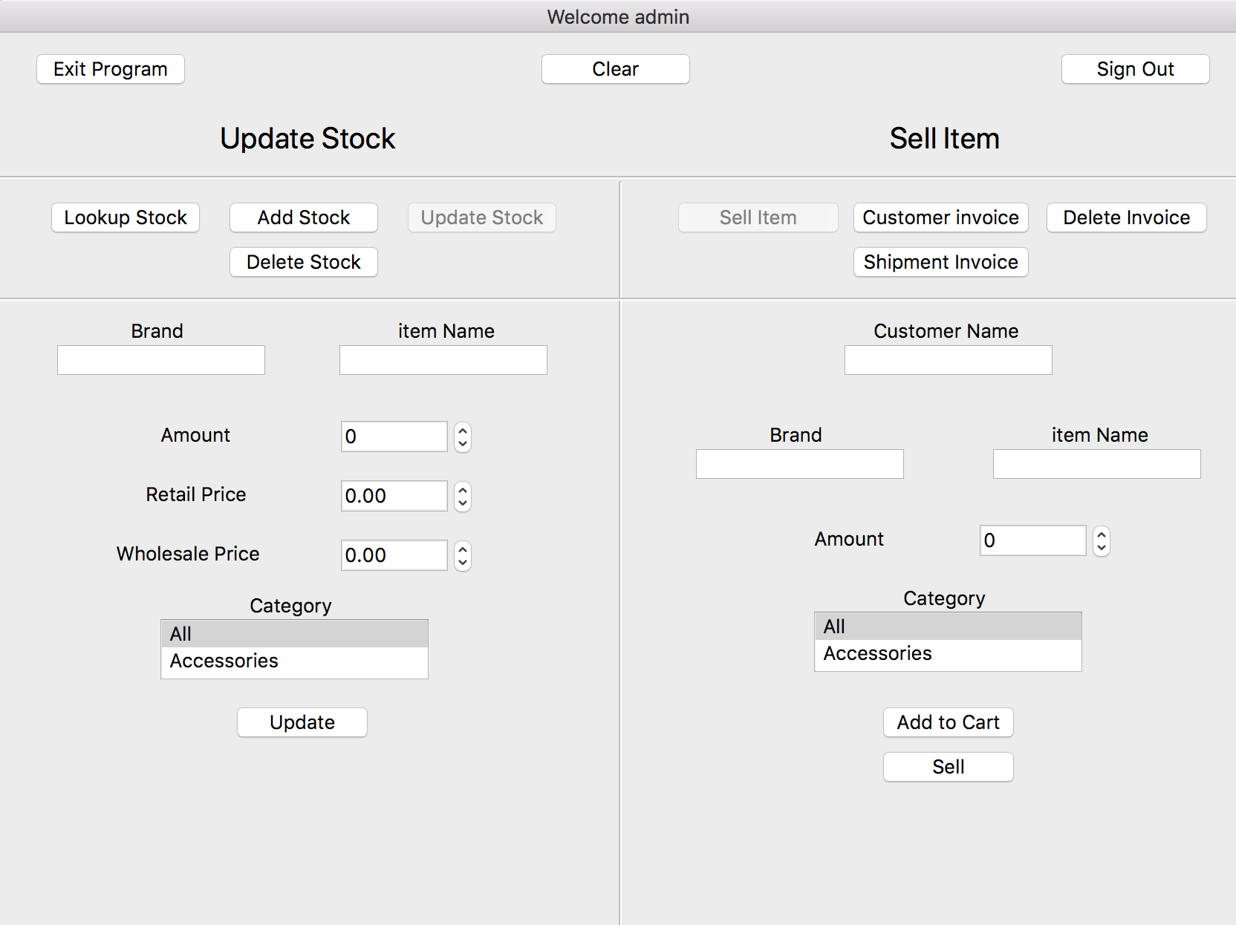
Main Program

Slide 5
Features
Manage Stock System
Lookup Stock
Allows to check if an item is available in stock
Add Stock
Allows an item to be added to the stock
Update Stock
Allows an item on the stock to be updated
Delete Stock
Allows an item on the stock to be deleted

Slide 6
Features
Sell Item/Manage Invoice System
Sell Item
Allows an item from the stock to be sold to a customer
Invoice is automatically generated after a sale
Customer Invoice
Allows to look up an invoice
Delete Invoice
Allows to delete an invoice
Shipment Invoice
Allows to receive incoming shipment invoice

Slide 7
Program Demo
Demonstration of the program...

